Slide 1
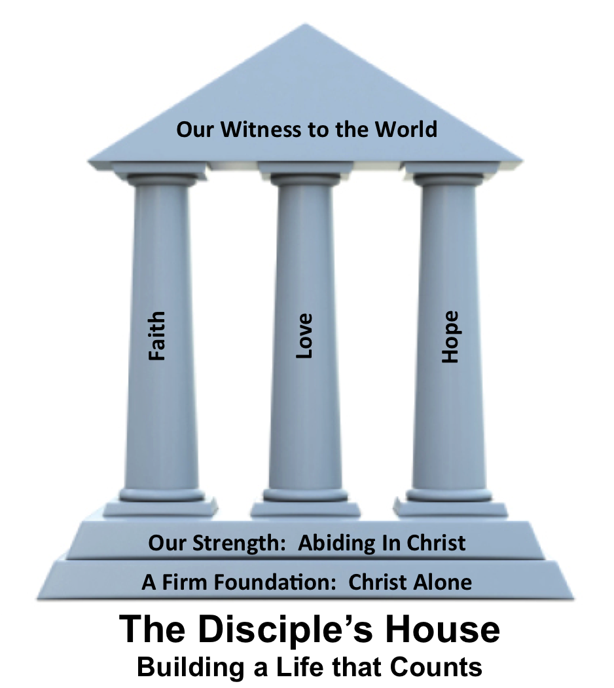
By Faith Galatians 2:20

Slide 3
Galatians 2:20
I have been crucified with Christ. It is no longer I who live, but Christ who lives in me. And the life I now live in the flesh I live by faith in the Son of God, who loved me and gave himself for me.

Slide 4
Faith
______ is the most solid possible conviction and God given assurance of a future reality based solely on the word of God
The evidence of faith is our ______________
Faith is the key to our _________________
faithfulness
transformation

Slide 5
Jesus
The object of our faith is _______
The motive of our faith is ___________
By faith, I believe that I have been _______ with Christ
gratitude
united

