Slide 1
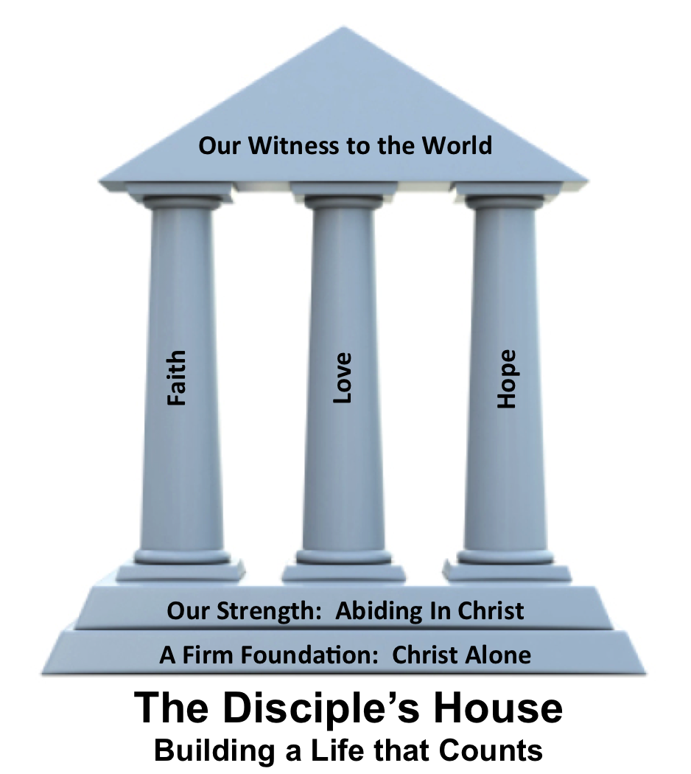
Who is Jesus?
Revelation 1:12-20

Slide 3
2 Timothy 3:10-17
¹⁰ You, however, have followed my teaching, my conduct, my aim in life, my faith, my patience, my love, my steadfastness, ¹¹ my persecutions and sufferings that happened to me at Antioch, at Iconium, and at Lystra—which persecutions I endured;
yet from them all the Lord
rescued me.

Slide 4
2 Timothy 3:10-17
¹² Indeed, all who desire to live a godly life in Christ Jesus will be persecuted, ¹³ while evil people and impostors will go on from bad to worse, deceiving and being deceived. ¹⁴ But as for you, continue in what you have learned
and have firmly believed, knowing
from whom you learned it

Slide 5
2 Timothy 3:10-17
¹⁵and how from childhood you have been acquainted with the sacred writings, which are able to make you wise for salvation through faith in Christ Jesus. ¹⁶ All Scripture is breathed out by God and profitable for teaching, for reproof, for correction, and for
training in righteousness,

Slide 6
2 Timothy 3:10-17
¹⁷ that the man of God may be complete, equipped for every good work.

Slide 7
To Abide in Christ is to remain in His _____
By following the ________ of _______
By being _______ as a _____
By __________ in the _____
word
example
others
trained
child
continuing
word

