Slide 1
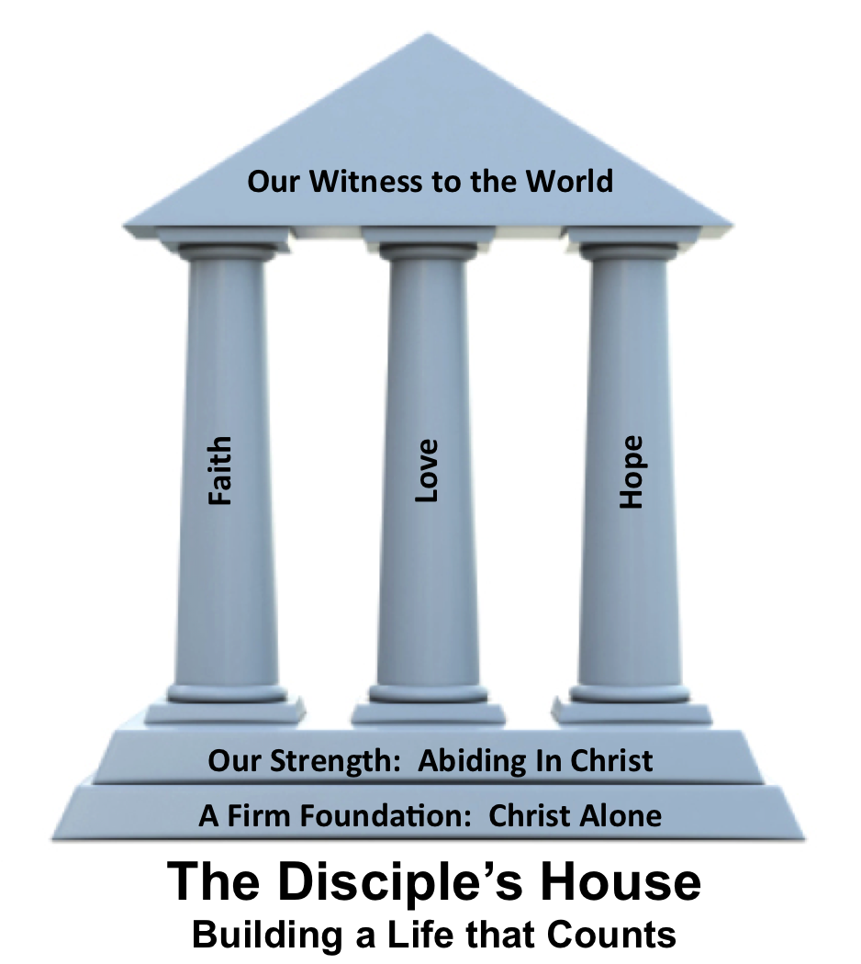
Who is Jesus Part 2 2 Corinthians 5:16-21

Slide 2
2 Corinthians 5:16-21
¹⁶ From now on, therefore, we regard no one according to the flesh. Even though we once regarded Christ according to the flesh, we regard him thus no longer.¹⁷ Therefore, if anyone is in Christ, he is a new creation. The old has passed away; behold, the new has come.
¹⁸ All this is from God, who
through Christ reconciled us to
himself and gave us the ministry
of reconciliation;

Slide 3
2 Corinthians 5:16-21
¹⁹ that is, in Christ God was reconciling the world to himself, not counting their trespasses against them, and entrusting to us the message of reconciliation. ²⁰ Therefore, we are ambassadors for Christ, God making his appeal through us. We implore you on behalf
of Christ, be reconciled to God.

Slide 4
2 Corinthians 5:16-21
²¹ For our sake he made him to be sin who knew no sin, so that in him we might become the righteousness of God.

Slide 5
What has Christ done
He has ____________ us
He has ____________ us
He has ____________ us
regenerated
reconciled
covered

Slide 6
What has Christ done
He has ____________ us
He has ____________ us
He has ____________ us
justified
forgiven
commissioned

