Slide 1
Revelation Revealed
When the Trumpet Sounds
Revelation 8:1-5 & 9:20-21

Slide 2
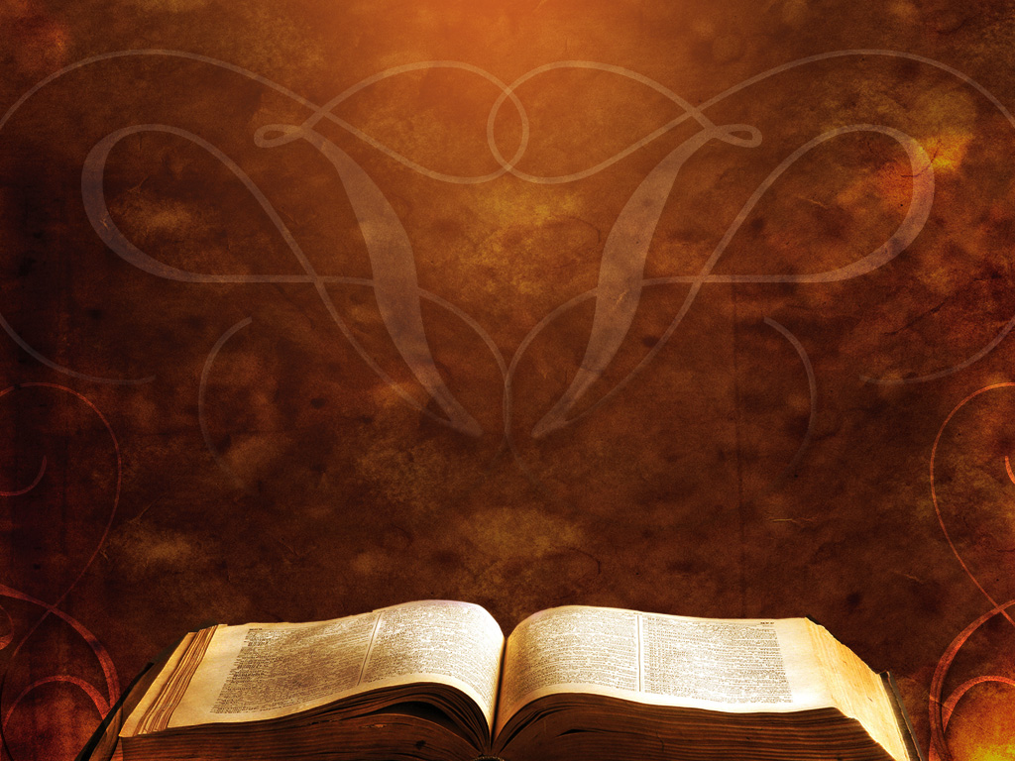
Revelation 8:1-5
When the Lamb opened the seventh seal, there was silence in heaven for about half an hour. ² Then I saw the seven angels who stand before God, and seven trumpets were given to them.

Slide 3
Revelation 8:1-5
³ And another angel came and stood at the altar with a golden censer, and he was given much incense to offer with the prayers of all the saints on the golden altar before the throne, ⁴ and the smoke of the incense, with the prayers of the saints, rose before God from the hand of the angel.

Slide 4
Revelation 8:1-5
⁵ Then the angel took the censer and filled it with fire from the altar and threw it on the earth, and there were peals of thunder, rumblings, flashes of lightning, and an earthquake.

Slide 5
Revelation 9:20-21
²⁰ The rest of mankind, who were not killed by these plagues, did not repent of the works of their hands nor give up worshiping demons and idols of gold and silver and bronze and stone and wood, which cannot see or hear or walk, ²¹ nor did they repent of their murders or their sorceries or their sexual immorality or their thefts.

Slide 6
Without the Holy Spirit people do not ______ God’s judgment is seen in the wrath of ______ God’s judgment is seen in the oppression by ________ God’s judgment is seen in the fall of _______
repent
nature
demons
nations

