Slide 3
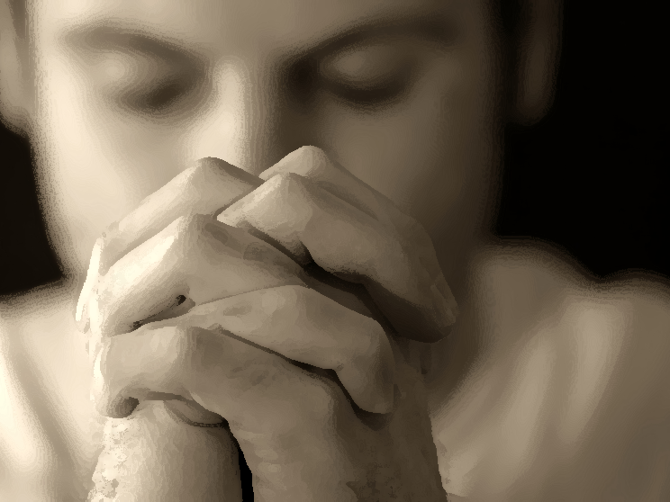

Slide 4
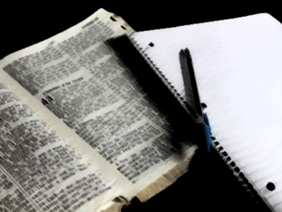

Slide 6
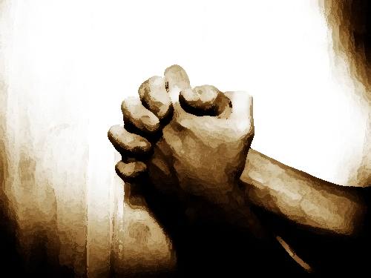

Slide 10
LIVING FAITHFUL
IN TROUBLED TIMES

Slide 11
LIVING FAITHFUL
IN TROUBLED TIMES

Slide 13
LIVING FAITHFUL
IN TROUBLED TIMES

