Slide 2
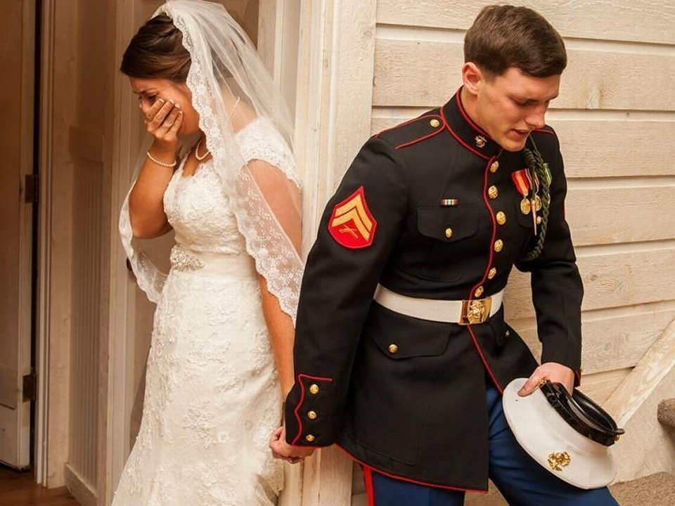

Slide 3
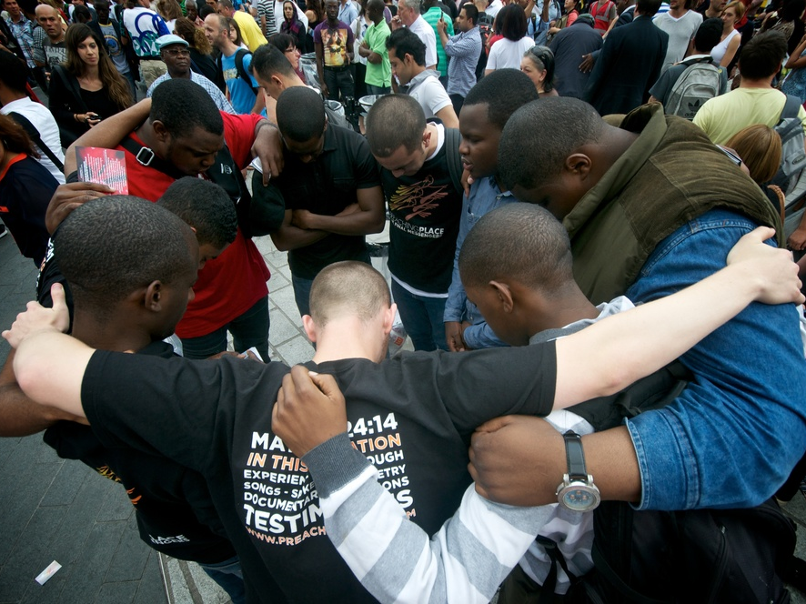

Slide 4
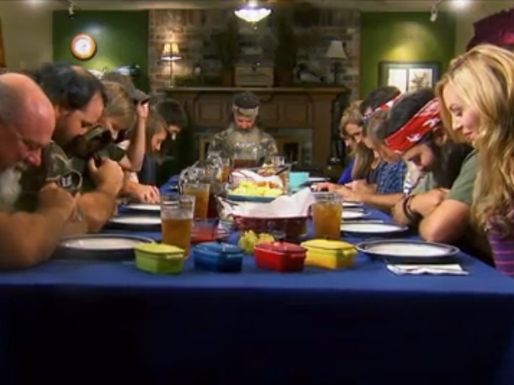

Slide 5
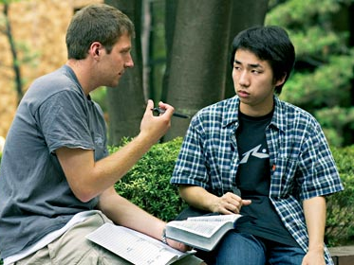

Slide 6
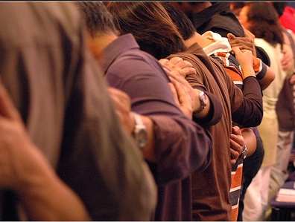

Slide 7
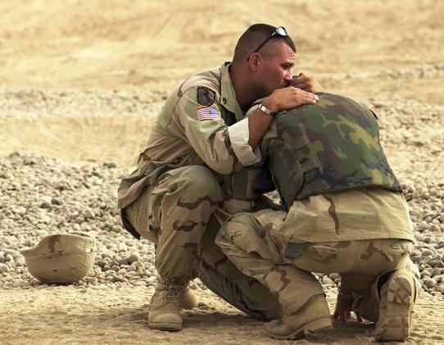

Slide 8
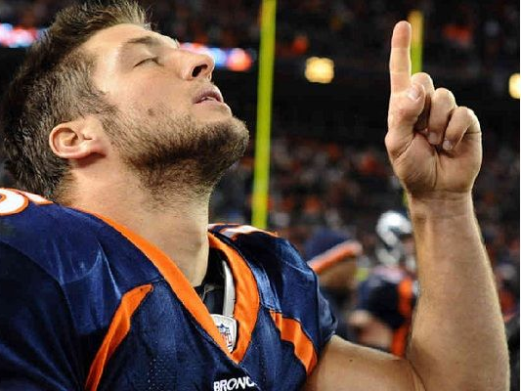

Slide 10
LIVING FAITHFUL
IN TROUBLED TIMES

Slide 11
LIVING FAITHFUL
IN TROUBLED TIMES

Slide 13
LIVING FAITHFUL
IN TROUBLED TIMES

Slide 16
love
gives
goes
grows

Slide 17
lives
quietly
mind our own business
self-supporting

