Slide 1
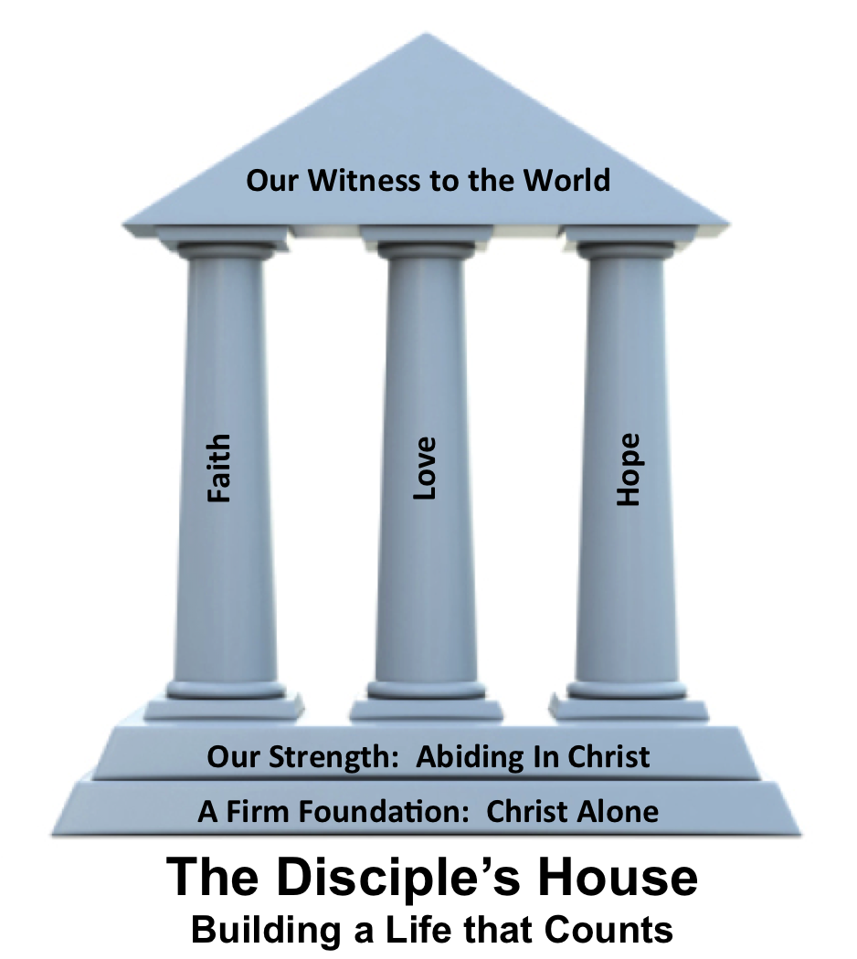
Abiding in Christ Through Prayer
John 15:7

Slide 3
1 Corinthians 13:4-7
⁴Love is patient and kind; love does not envy or boast; it is not arrogant ⁵or rude. It does not insist on its own way; it is not irritable or resentful; ⁶it does not rejoice at wrongdoing, but rejoices with the truth. ⁷Love bears all things, believes
all things, hopes all things,
endures all things.

Slide 4
____________ love, love that demands something of us.
This kind of love is so __________ to human nature.

Slide 5
Self-giving love, love that demands something of us.
This kind of love is so __________ to human nature.

Slide 6
Self-giving love, love that demands something of us.
This kind of love is so unnatural to human nature.

Slide 7
• Love __________ being patient
• Love ____________ kindness
• Love _________ for others
• Love acts in ___________

Slide 8
• Love practices being patient
• Love ____________ kindness
• Love _________ for others
• Love acts in ___________

Slide 9
• Love practices being patient
• Love demonstrates kindness
• Love _________ for others
• Love acts in ___________

Slide 10
• Love practices being patient
• Love demonstrates kindness
• Love rejoices for others
• Love acts in ___________

Slide 11
• Love practices being patient
• Love demonstrates kindness
• Love rejoices for others
• Love acts in humbleness

