Slide 1
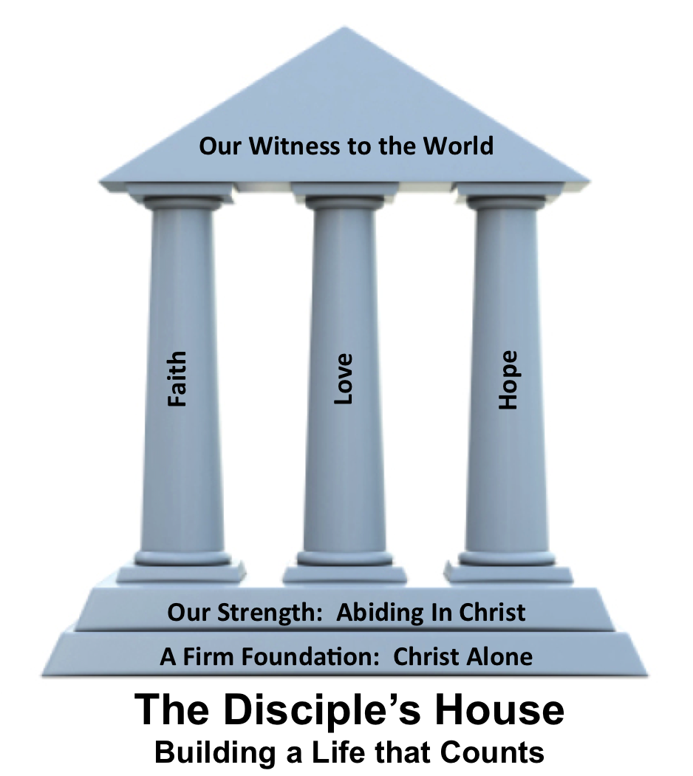
Hope: The Full Armor of God
Ephesians 6:10-20

Slide 3
Ephesians 6:10-20
¹⁰ Finally, be strong in the Lord and in the strength of his might. ¹¹ Put on the whole armor of God, that you may be able to stand against the schemes of the devil. ¹² For we do not wrestle against flesh and blood, but against the rulers, against
the authorities, against the

Slide 4
Ephesians 6:10-20
cosmic powers over this present darkness, against the spiritual forces of evil in the heavenly places. ¹³ Therefore take up the whole armor of God, that you may be able to withstand in the
evil day, and having done all,
to stand firm.

Slide 5
Ephesians 6:10-20
¹⁴ Stand therefore, having fastened on the belt of truth, and having put on the breastplate of righteousness ¹⁵and, as shoes for your feet, having put on the readiness given by the gospel of peace. ¹⁶ In all circumstances take up the
shield of faith, with which

Slide 6
Ephesians 6:10-20
you can extinguish all the flaming darts of the evil one; ¹⁷ and take the helmet of salvation, and the sword of the Spirit, which is the word of God, ¹⁸ praying at all times in the Spirit, with all
prayer and supplication.

Slide 7
Ephesians 6:10-20
To that end, keep alert with all perseverance, making supplication for all the saints, ¹⁹ and also for me, that words may be given to me in opening my mouth boldly to proclaim the mystery of the gospel, ²⁰ for which I am an ambassador in chains, that
I may declare it boldly, as
I ought to speak.

Slide 8
Putting on the Belt of Truth
When we see our world, believe and live by God’s truth we are ______.
We must fill our lives with God’s _____.

Slide 9
Putting on the Belt of Truth
When we see our world, believe and live by God’s truth we are stable.
We must fill our lives with God’s _____.

Slide 10
Putting on the Belt of Truth
When we see our world, believe and live by God’s truth we are stable.
We must fill our lives with God’s truth.

Slide 11
Putting on the Breastplate of Righteousness
_____ your need
____ for provision
_____ His promises
___ in Faith

Slide 12
Putting on the Breastplate of Righteousness
Admit your need
____ for provision
_____ His promises
___ in Faith

Slide 13
Putting on the Breastplate of Righteousness
Admit your need
Pray for provision
_____ His promises
___ in Faith

Slide 14
Putting on the Breastplate of Righteousness
Admit your need
Pray for provision
Trust His promises
___ in Faith

Slide 15
Putting on the Breastplate of Righteousness
Admit your need
Pray for provision
Trust His promises
Act in Faith

Slide 16
Putting on the Shoes of Peace
Be ready to ____ forgiveness
Be ready to ____ forgiveness
Be ready to _____ forgiveness

Slide 17
Putting on the Shoes of Peace
Be ready to seek forgiveness
Be ready to ____ forgiveness
Be ready to _____ forgiveness

Slide 18
Putting on the Shoes of Peace
Be ready to seek forgiveness
Be ready to give forgiveness
Be ready to _____ forgiveness

Slide 19
Putting on the Shoes of Peace
Be ready to seek forgiveness
Be ready to give forgiveness
Be ready to share forgiveness

