Slide 1
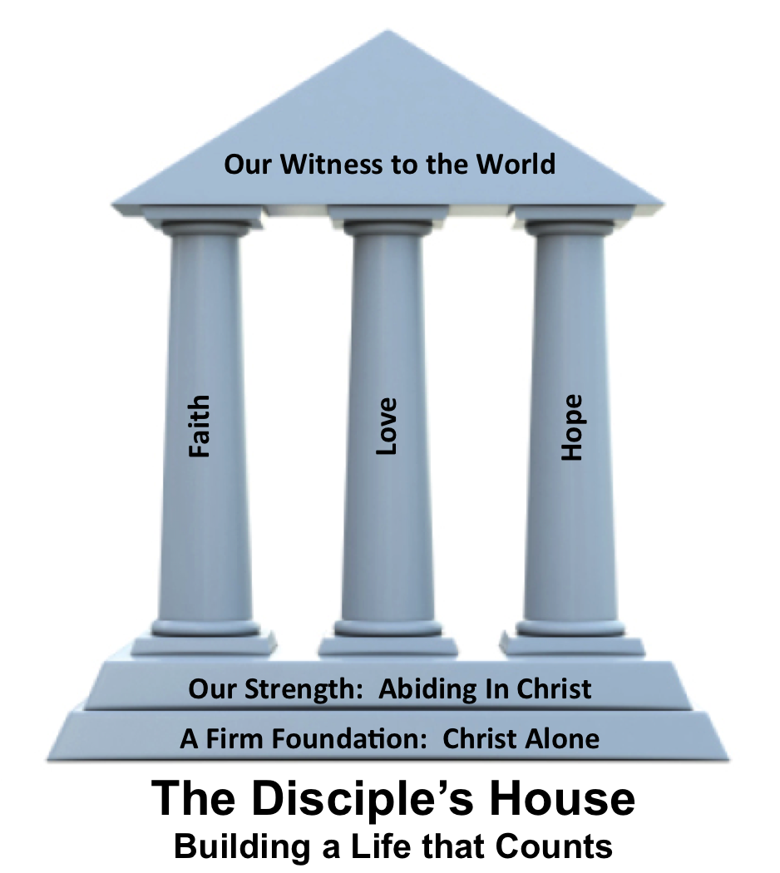
Mortify
Colossians 3:5-9

Slide 3
Colossians 3:5-10
⁵ Put to death therefore what is earthly in you: sexual immorality, impurity, passion, evil desire, and covetousness, which is idolatry. ⁶ On account of these the wrath of God is coming. ⁷ In these you too once walked, when you were
living in them.

Slide 4
Colossians 3:5-10
⁸ But now you must put them all away: anger, wrath, malice, slander, and obscene talk from your mouth. ⁹ Do not lie to one another, seeing that you have put off the old self with its practices ¹⁰ and have put on the new self, which is being renewed
in knowledge after the image
of its creator.

Slide 5
By faith we _________ sin
Get to the ______ of the problem
mortify
root

Slide 6
why
Don’t forget the _____
God still ________
You are not _____ you ______ ___ ___
judges
who used to be

Slide 7
stop
You can’t ______ something without __________ something.
starting

