Slide 1
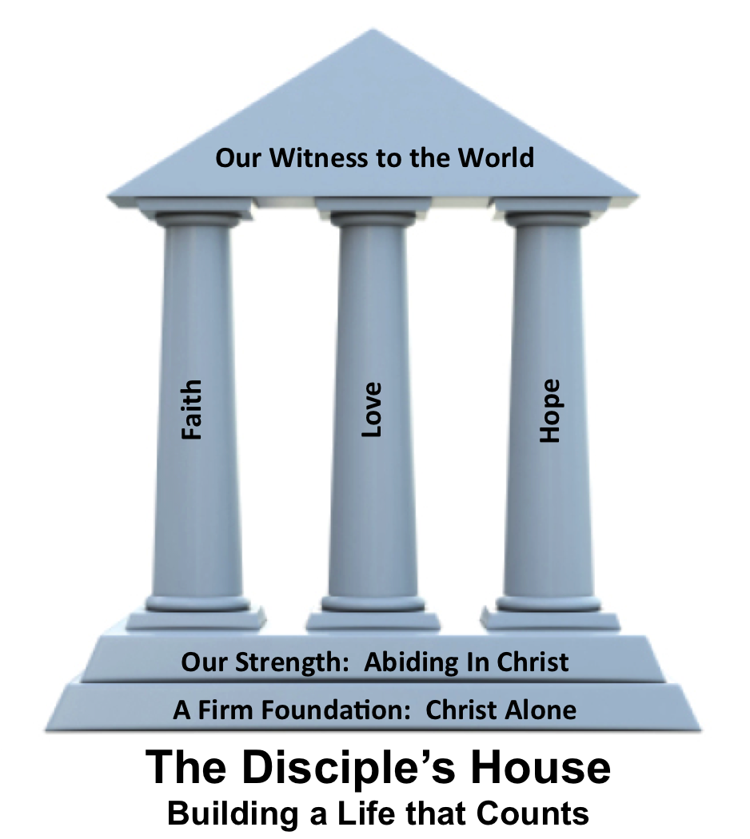
Brand New
2 Corinthians 5:14-17

Slide 3
2 Corinthians 5:14-17
¹⁴ For the love of Christ controls us, because we have concluded this: that one has died for all, therefore all have died; ¹⁵ and he died for all, that those who live might no longer live for themselves but
for him who for their sake
died and was raised.

Slide 4
2 Corinthians 5:14-17
¹⁶ From now on, therefore, we regard no one according to the flesh. Even though we once regarded Christ according to the flesh, we regard him thus no longer. ¹⁷ Therefore, if anyone is
in Christ, he is a new creation.
The old has passed away;
behold, the new has come.

Slide 5
Because I am brand new:
The love of Christ __________ me
I live for _____ not for ____
I see ___________ including _________ through _______
controls
Him
me
everyone myself
Christ

