Slide 1
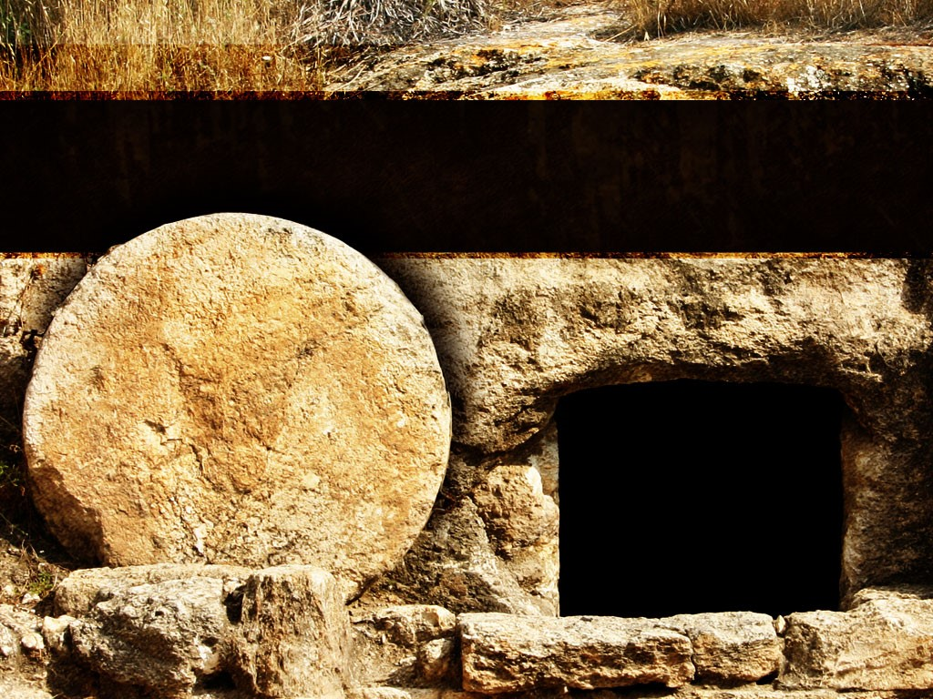
The Miracles of the Resurrection
Matthew 27:57-66

Slide 2
Matthew 27:57-66
⁵⁷ When it was evening, there came a rich man from Arimathea, named Joseph, who also was a disciple of Jesus. ⁵⁸ He went to Pilate and asked for the body of Jesus. Then Pilate ordered it to be given to him.

Slide 3
Matthew 27:57-66
⁵⁹ And Joseph took the body and wrapped it in a clean linen shroud ⁶⁰ and laid it in his own new tomb, which he had cut in the rock. And he rolled a great stone to the entrance of the tomb and went away. ⁶¹ Mary Magdalene and the other Mary were there, sitting opposite the tomb.

Slide 4
Matthew 27:57-66
⁶² The next day, that is, after the day of Preparation, the chief priests and the Pharisees gathered before Pilate ⁶³ and said, “Sir, we remember how that impostor said, while he was still alive, ‘After three days I will rise.’

Slide 5
Matthew 27:57-66
⁶⁴ Therefore order the tomb to be made secure until the third day, lest his disciples go and steal him away and tell the people, ‘He has risen from the dead,’ and the last fraud will be worse than the first.”⁶

Slide 6
Matthew 27:57-66
⁵ Pilate said to them, “You have a guard of soldiers. Go, make it as secure as you can.” ⁶⁶ So they went and made the tomb secure by sealing the stone and setting a guard.

Slide 7
God provides proof of the resurrection at Jesus’ burial:
· __________ proof
· ____________ proof
· ____________ proof
Prophetic
Eyewitness
Undeniable

