Slide 2
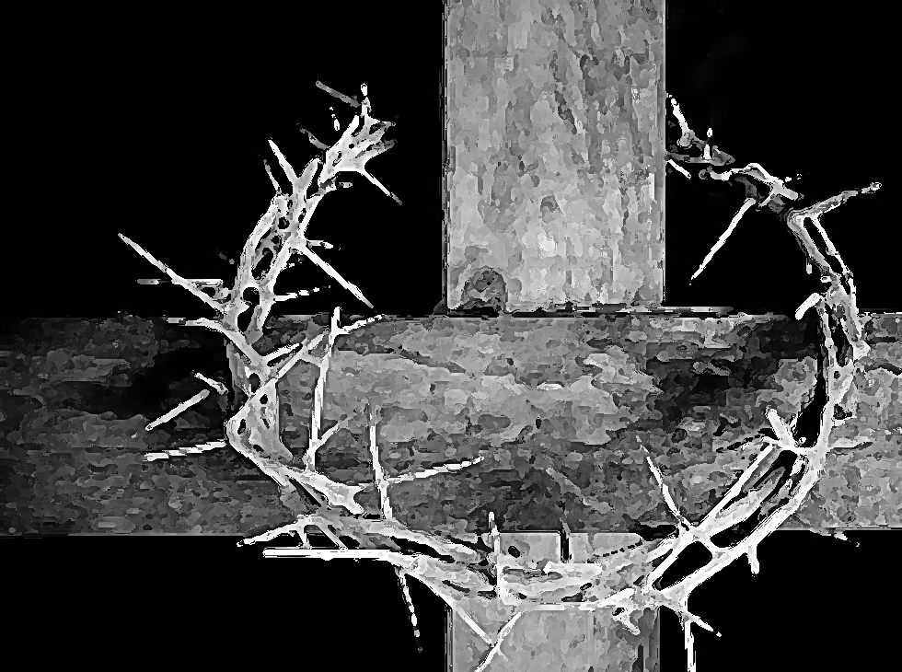

Slide 3
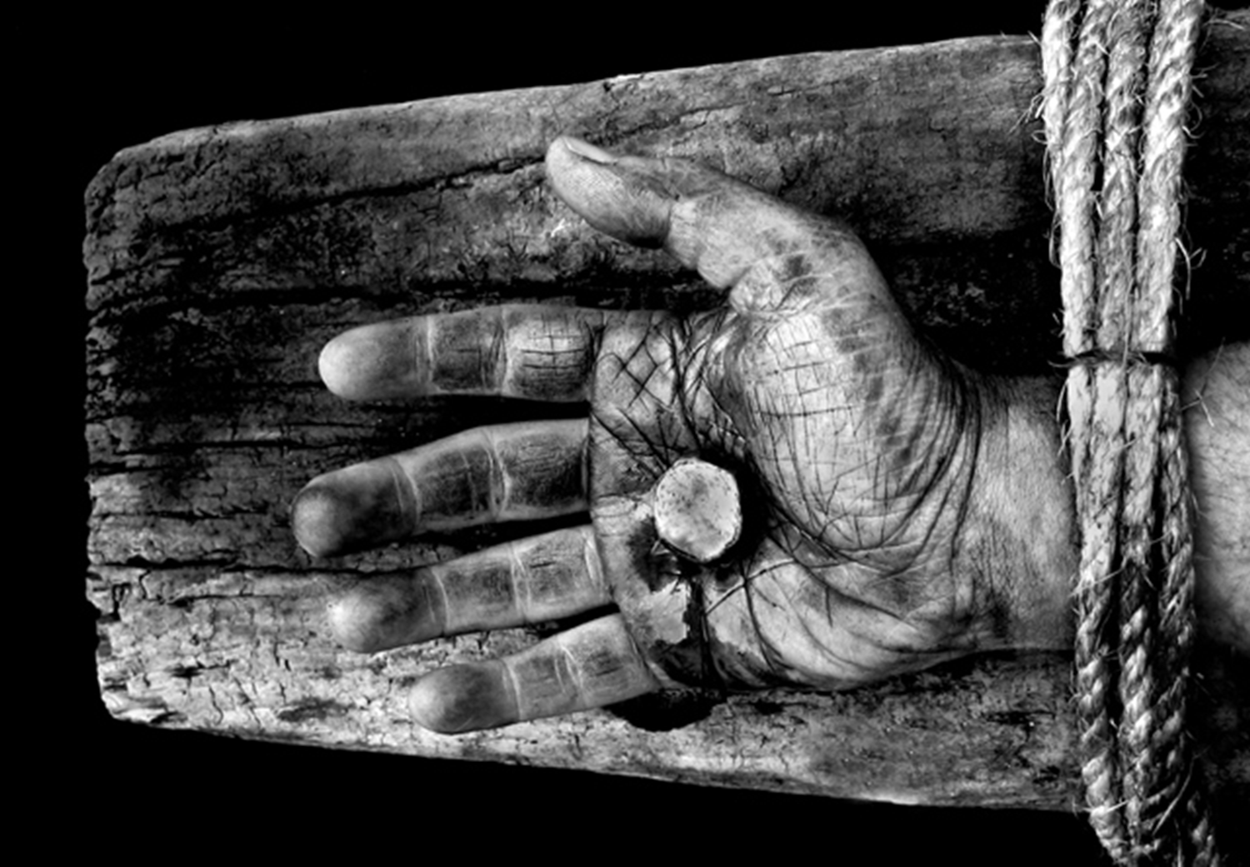

Slide 4
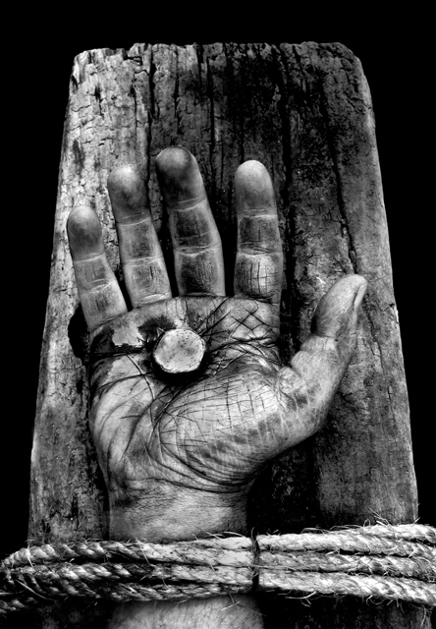

Slide 5
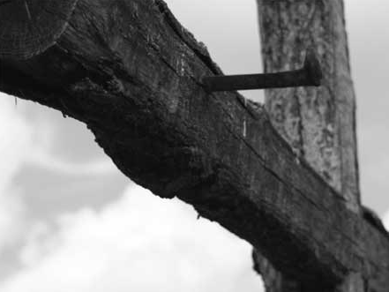

Slide 6
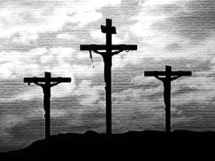

Slide 8
LIVING FAITHFUL
IN TROUBLED TIMES

Slide 9
LIVING FAITHFUL
IN TROUBLED TIMES

Slide 11
LIVING FAITHFUL
IN TROUBLED TIMES

Slide 16
past
future

Slide 17
grief
fears

