Slide 3
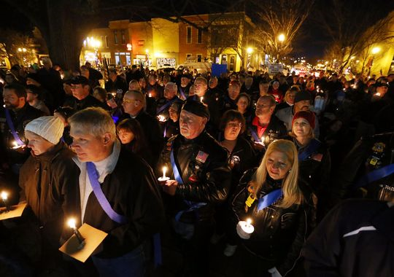

Slide 4
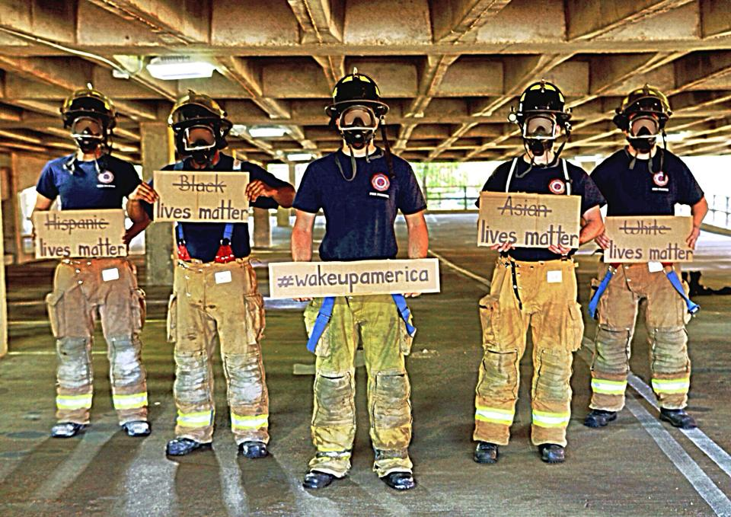

Slide 5
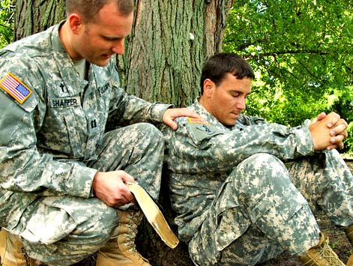

Slide 6
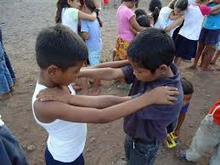

Slide 7
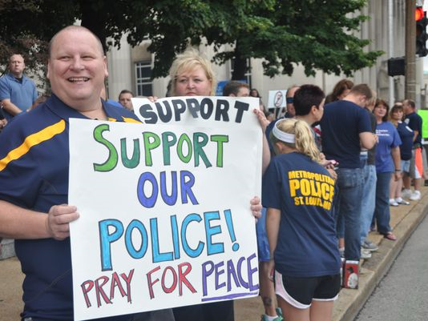

Slide 8
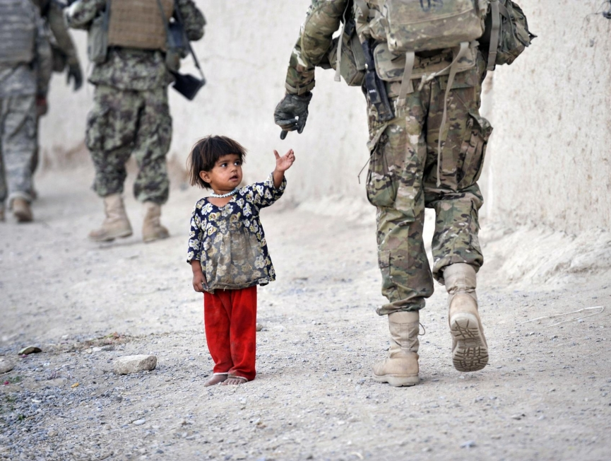

Slide 9
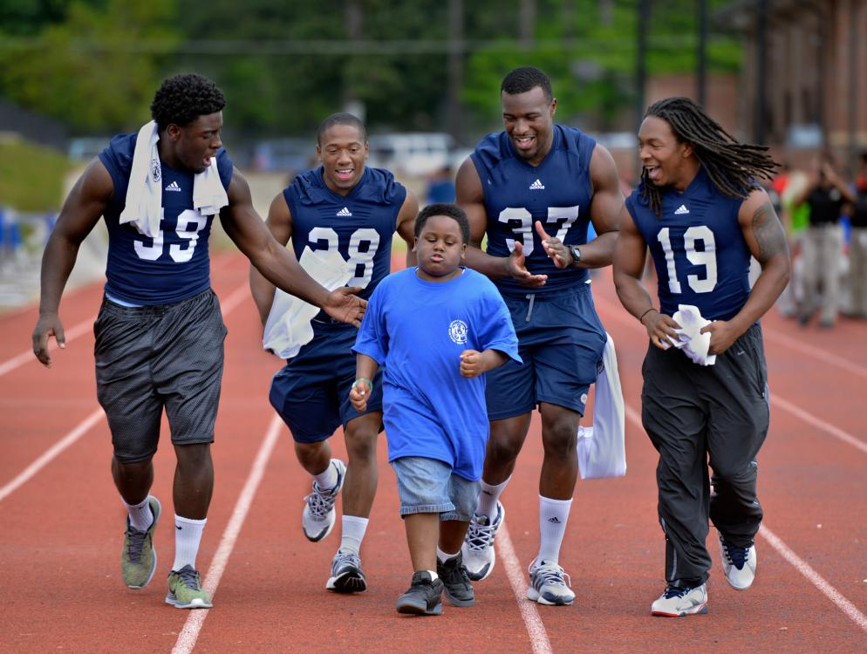

Slide 10
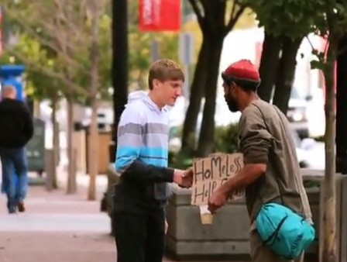

Slide 11
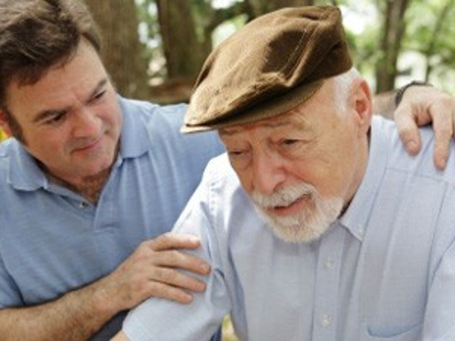

Slide 15
LIVING FAITHFUL
IN TROUBLED TIMES

Slide 16
LIVING FAITHFUL
IN TROUBLED TIMES

Slide 18
LIVING FAITHFUL
IN TROUBLED TIMES

Slide 24
words
express
love
importance

Slide 25
actions
perform
selves
need

Slide 26
truth
share
return
sovereignty

